Slide 1
Predictive Modeling
20 September, 2021

Slide 2
Answering Q3
What attributes of external support (externally provide training, coaching, DESE support) influence the rate of improving instruction? What are the conditions that cause the contribution of these variables to vary?
“Improving instruction”: increase in ETLP domain on CWIS
Possible influencing variables
Q3 part (Training format: virtual learning platform or trainer or both)
Datasets: CWIS, Coaching Logs
For primary analysis NCES data not included
Possible Question:
Does the consistency of coaching influence the rate of improving instruction?

Slide 3
Consistency Measure
Frequency
Once per month
No. of times per month
Gap/Stop
No. of empty month
Duration of coaching session

Slide 4
Questions
Duration of how many hours of coaching session is good, for consistency measure?
For answering Q3, what column can be used for Training format ?
What columns in NCES data can be used in this case?

Slide 5
Target Data Table
Aggregate CWIS, Coaching logs & NCES --> 1 district format
Aggregate <- DT[ , (), by = (State.District.ID, year)]
State District ID | Year | Consistency Measure
MO-002097 | 2019
MO-002097 | 2020
MO-004110 | 2019
… | …
Each rows ---> different districts in different years

Slide 6
Datasets
CWIS
contains the State District ID, district name, building name, survey data of the coaching
Rows 80,317 x Columns 106
Each rows represents a survey response of a school/building within a district
ETL AVERAGE comes from CWIS
Building/school level data

Slide 7
Datasets
contains the State District ID, timestamp, duration of event, interaction type of the trainings occurred, description of the learning patterns.
Coaching Logs
Rows 11,556 x Columns 58
Each row represents coaching session between the educator and the school
Data created from the survey of 2020 - 2021 DCI CST Consultant Report
District level data

Slide 8
Merging of the data
CWIS
State District ID
Coaching Logs
Not Optimal
Approach
Rows = 4615311, Columns = 169

Slide 9
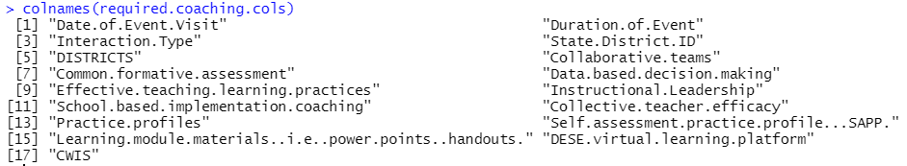
Coaching Data
Relevant Columns = 17

Slide 10
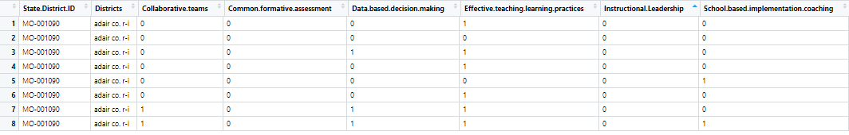
Aggregate Coaching Data How?
Operation = OR between the coaching survey values of different schools in same district
Total Districts = 192
Columns = 14

Slide 11
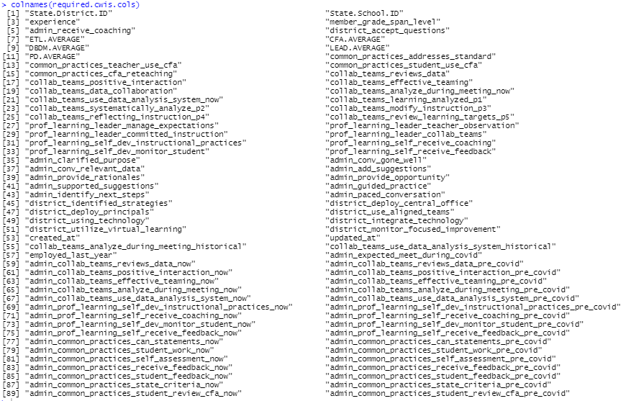
CWIS Data
Relevant Columns = 90

Slide 12
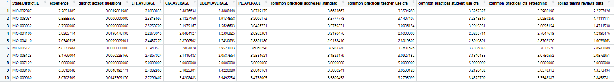
Aggregate CWIS How?
Operation = MEAN between the survey values of different schools in same district
Aggregate <- DT[ , mean(each_column), by = State.District.ID]
Total Districts = 230
Columns = 86

Slide 13
Aggregate(CWIS, Coaching Logs)
Rows = 186, Columns = 101
Only common districts are taken
Each row represents cwis survey per district and coaching level data
Some districts had cwis survey data but no coaching logs data

Slide 14
Future works
Merge the three datasets for the training format question
Apply models with the dataset

